Slide 1
COBOL und C
C++ UG HH 17.09.2025

Slide 2
C - Programm Teil 1
#include <stdio.h>
#include <string.h>
extern int cob_init(int argc, char **argv);
extern void cob_stop_run(int status);
extern void cobol_sub(int *num1, int *num2, int *sum, char *message);

Slide 3
C-Programm Teil 2
int main(int argc, char *argv[]) {
if (cob_init(argc, argv) != 0) {
fprintf(stderr, "Error: Failed to initialize GnuCOBOL runtime.\n");
return 1;
}
int a = 15;
int b = 27;
int the_sum = 0;
char message_from_cobol[51];
memset(message_from_cobol, 0, sizeof(message_from_cobol));

Slide 4
C-Programm Teil 3
printf("C: Calling COBOL subprogram with a=%d, b=%d\n", a, b);
cobol_sub(&a, &b, &the_sum, message_from_cobol);
printf("C: Back from COBOL.\n");
printf("C: Message received: '%s'\n", message_from_cobol);
printf("C: Sum received: %d\n", the_sum);

Slide 5
C-Programm Teil 4
cob_stop_run(0);
return 0;
}

Slide 6
COBOL-Unterprogramm Teil 1
IDENTIFICATION DIVISION.
PROGRAM-ID. cobol_sub.
DATA DIVISION.
LINKAGE SECTION.
01 LNK-NUM1 PIC S9(9) COMP-5.
01 LNK-NUM2 PIC S9(9) COMP-5.
01 LNK-SUM PIC S9(9) COMP-5.
01 LNK-MESSAGE PIC X(50).

Slide 7
COBOL-Unterprogramm Teil 2
PROCEDURE DIVISION USING LNK-NUM1, LNK-NUM2, LNK-SUM,
LNK-MESSAGE.
COMPUTE LNK-SUM = LNK-NUM1 + LNK-NUM2
MOVE "Hello from GnuCOBOL!" TO LNK-MESSAGE
*> X"00" is the hexadecimal representation of the null byte.
MOVE X"00" TO LNK-MESSAGE(22:1)
GOBACK.

Slide 8
Compilieren / Linken
cobc -c sub.cob
gcc -c main.c
gcc -o c-calls-cobol main.o sub.o -lcob
./c-calls-cobol

Slide 9
astro@MU-TH-R-182:~/prj/cobol$ ./c-calls-cobol
Here is C speaking...
C: Calling COBOL subprogram with a=15, b=27
C: Back from COBOL.
C: Message received: 'Hello from GnuCOBOL! '
C: Sum received: 42
astro@MU-TH-R-182:~/prj/cobol$

Slide 10
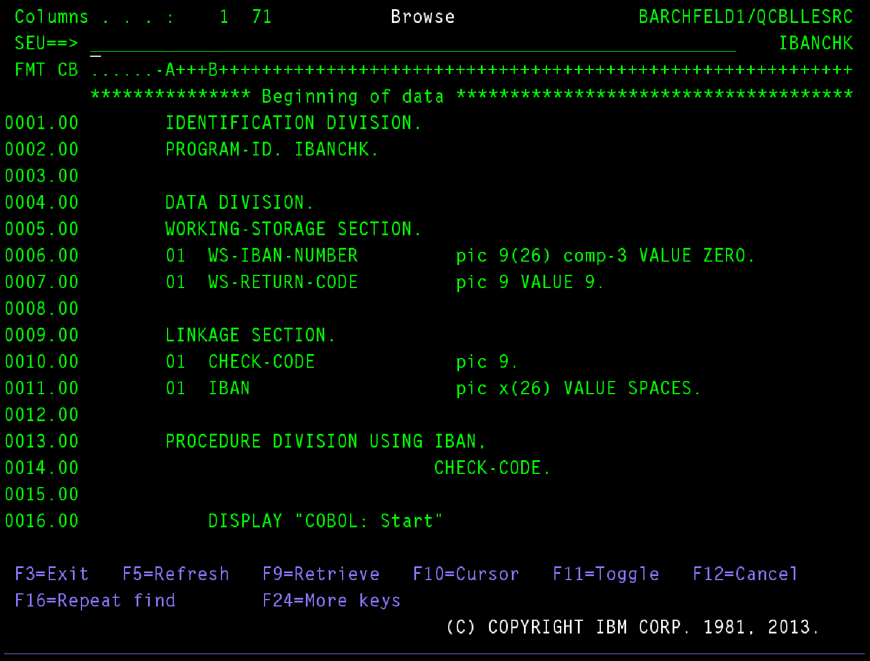

Slide 11
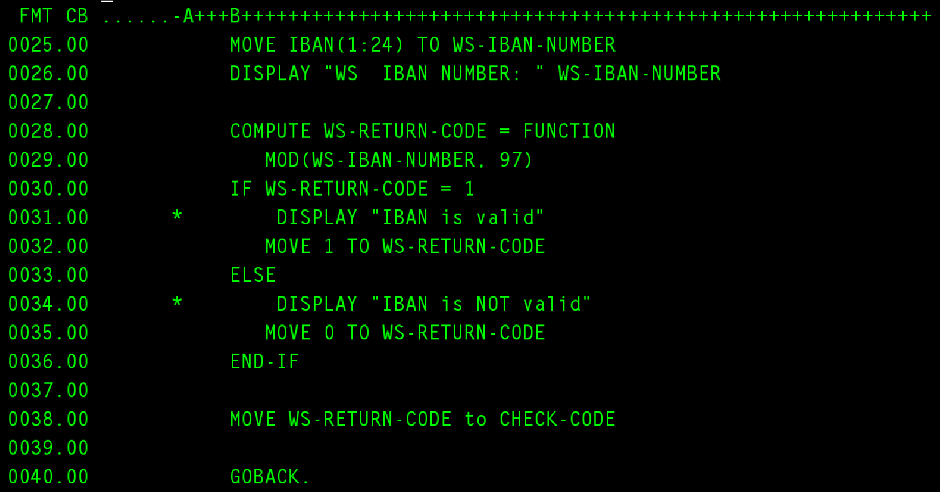

Slide 12
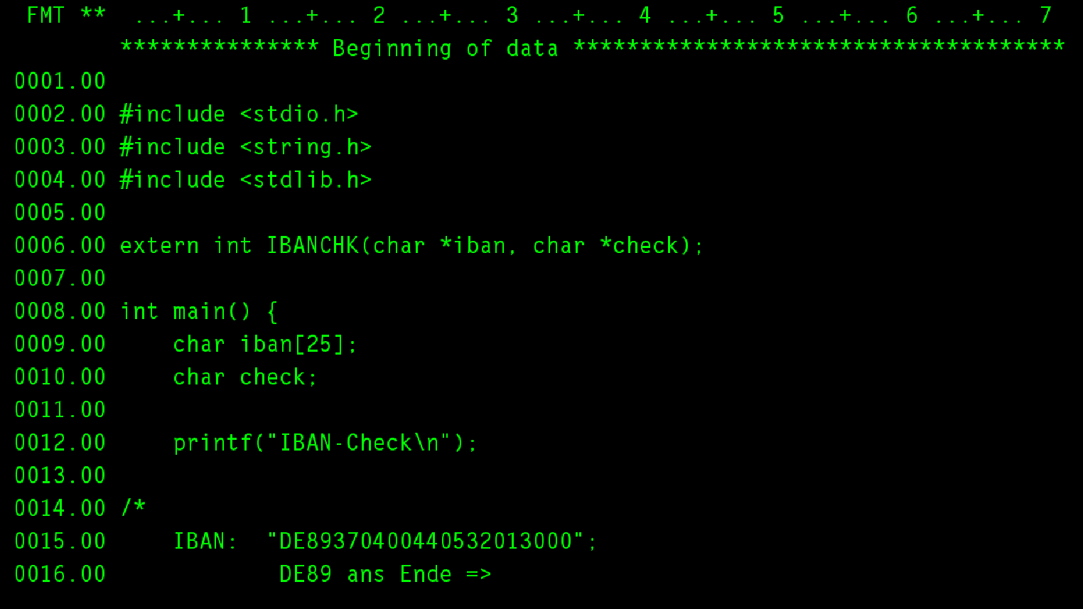

Slide 13
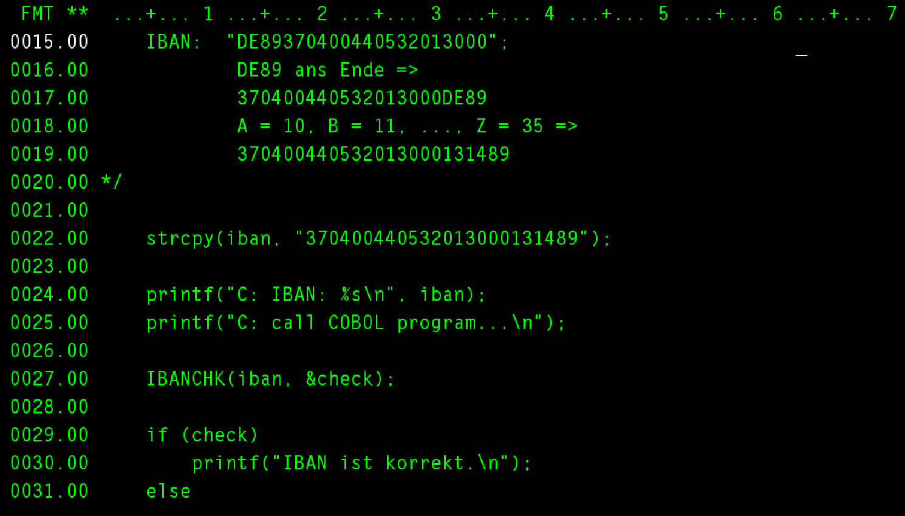

Slide 14
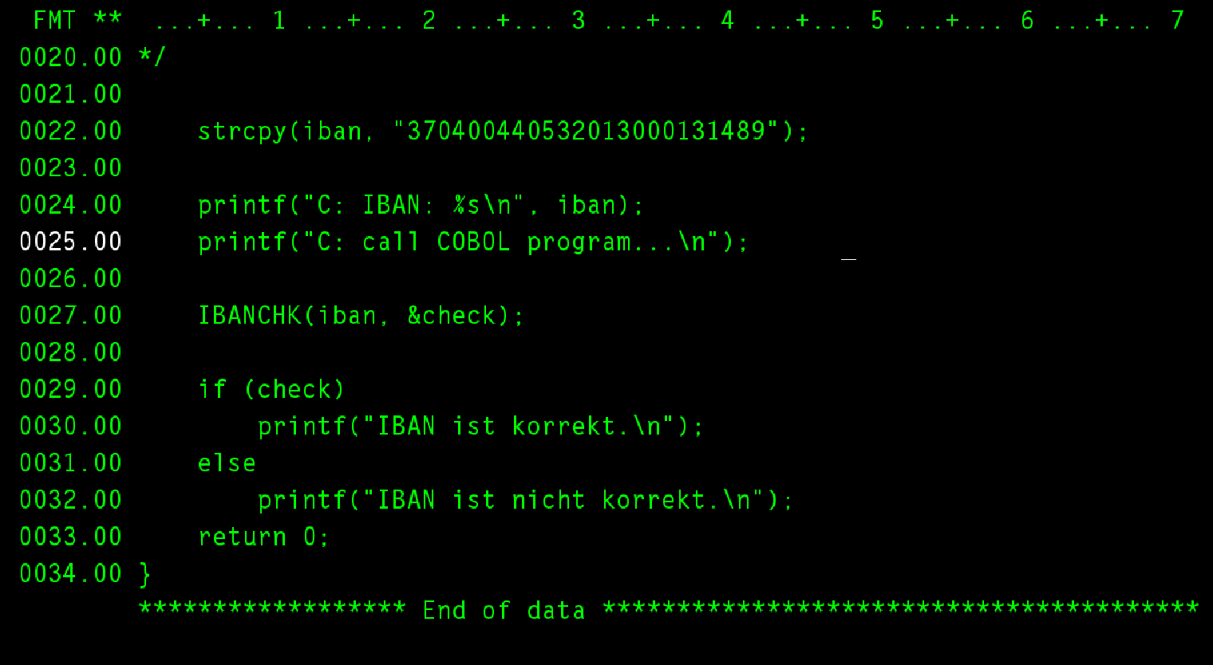

Slide 15
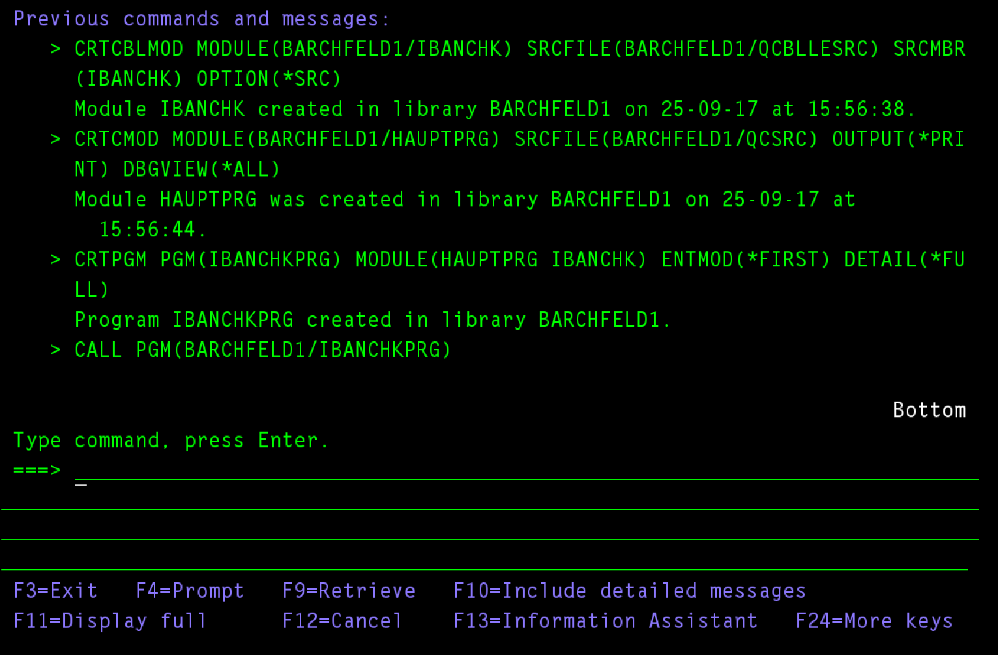

Slide 16
